Slide 1
Algebraic Reconstruction Techniques on Sinogram Image of Solder Ball Grid
Rohit Das
Advised By – Prof. Chiou-Shann Fuh
61047086s@ntnu.edu.tw
+886-0905023713

Slide 2
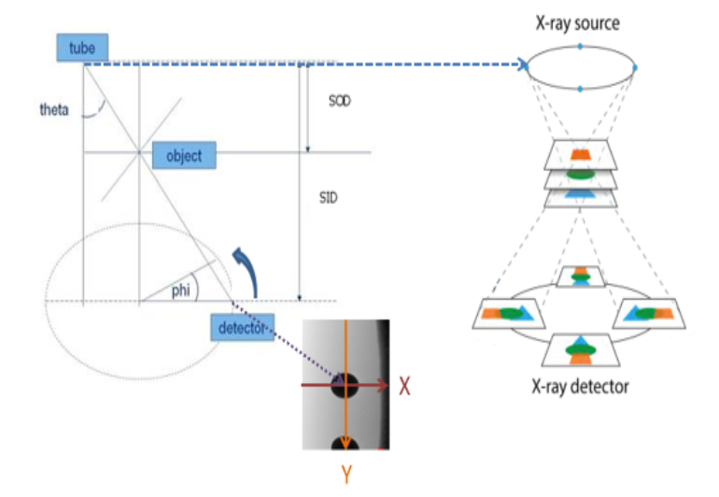
Introduction
SOD – Source to Object Distance
SID – Source to Image Distance
Notes:
Rotational Laminography
Phi = 360

Slide 3
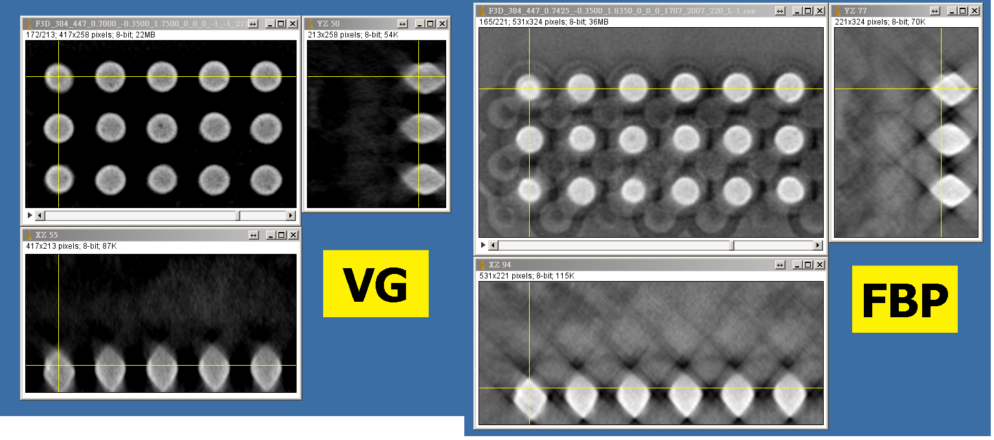
The Problem
VG: Volume Graphics
FBP: Filtered Back Projection
The solder balls are too rhombus
Image contrast not clear enough (voids are dark spots)

Slide 4
Research progress
Sinogram
Algebraic Reconstruction Technique

Slide 5
Sinogram
The Radon Function (Sinogram) computes projections of an image matrix along specified directions.
Widely applicable in Computer Tomography
Sinogram
Gif source - https://en.wikipedia.org/wiki/File:Radon_transform_sinogram.gif
Notes:
CT never creates images. It throws beams to the
dividing the measured photon counts by the incident photon counts and taking the negative logarithm yields samples of the Radon transform of the linear attenuation map. from measured projection or scattering data. object. And these beams are then reconstructed to images.

Slide 6

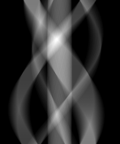


Sinogram
I have found two methods
Inbuilt Function – skimage_transformation.radon()
Iterative Algorithm
179$°$
0$°$
Original Image
Expected Sinogram

Slide 7
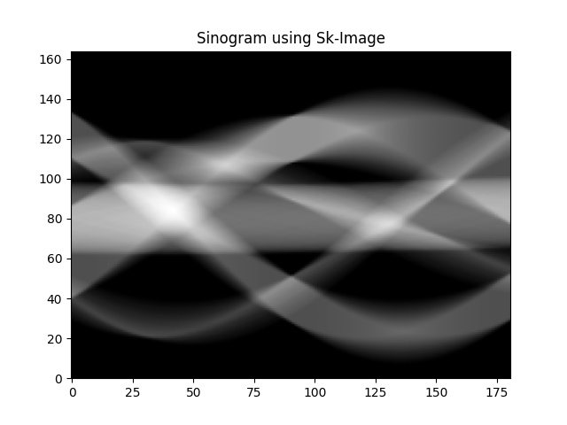
Inbuilt Function – skimage_transformation.radon()
Notes:
Sk_image .radon
But it’s not horizontal
Well I can rotate the image but does the value change or will change?
Is it doing by using columns or rows?
More research is needed!

Slide 8
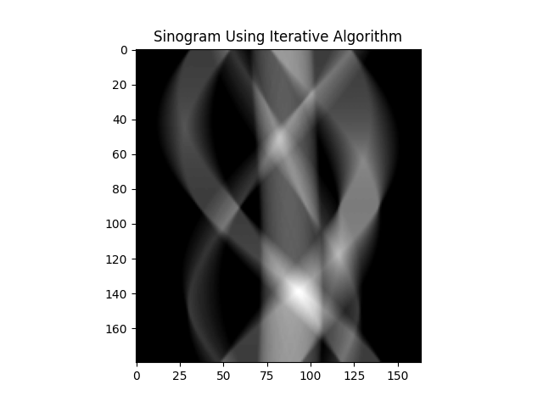
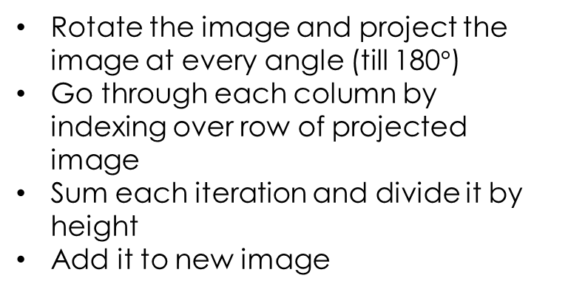
Iterative Algorithm
Rotate the image and project the image at every angle (till 180$°$)
Go through each column by indexing over row of projected image
Sum each iteration and divide it by height
Add it to new image

Slide 9
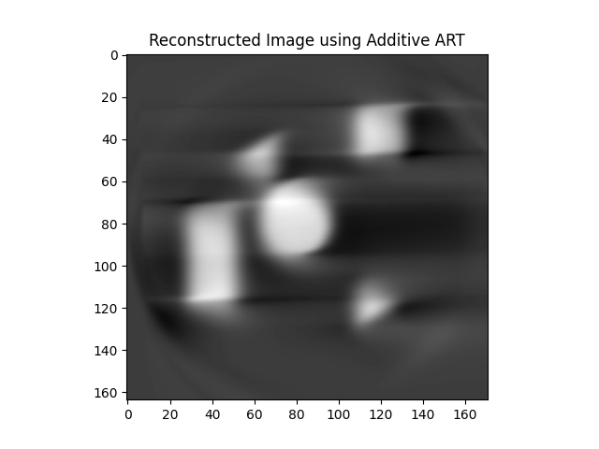
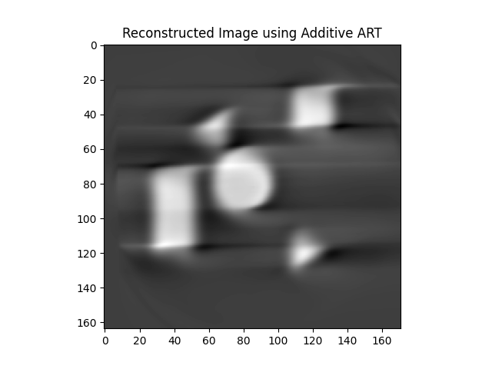

Algebraic Reconstruction Technique
Using Additive method: Horizontal
1 iteration
10 iterations
100 iterations
Notes:
The image though comes out good enough reconstructed still has too much loss of information.

Slide 10
Thank You!

